Slide 1
A case study from Indian e-commerce customers
SUBMITTED BY: RITU RANI

Slide 2
OVERVIEW:
Customer satisfaction has emerged as one of the most important factors that guarantee the success of online store; it has been posited as a key stimulant of purchase, repurchase intentions and customer loyalty. A comprehensive review of the literature, theories and models have been carried out to propose the models for customer activation and customer retention. Five major factors that contributed to the success of an e-commerce store have been identified as: service quality, system quality, information quality, trust and net benefit. The research furthermore investigated the factors that influence the online customers repeat purchase intention. The combination of both utilitarian value and hedonistic values are needed to affect the repeat purchase intention (loyalty) positively. The data is collected from the Indian online shoppers. Results indicate the e-retail success factors, which are very much critical for customer satisfaction.

Slide 3
In this model we will predict:
What are the major factors that contributed to the success of an e-commerce store.
Business Goal:
We are required to find out the major factors which contributed to the success of an e-commerce store. Other e-commerce websites can accordingly manipulate the strategy and concentrate on areas that will yield high returns. Further, the model will be a good way for the management to understand the behavior of Indian e-commerce customers.

Slide 4
OVERVIEW:
• Data contains 269 entries each having 71 variables.
• Data contains no Null values.
• We perform Extensive EDA to find out major factors that contributed to the success of an e-commerce store
• Data contains numerical as well as categorical variable.
• We will find important features which affect the trust of e-commerce customers positively or negatively.

Slide 5
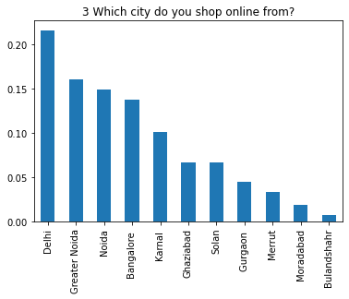
LOADING DATASET
The data set is of shape (269,71) i.e. It has 71 attributes and 269 rows.
The dataset is mixture of ordinal, categorical and numerical data types.
EXPLORATORY DATA ANALYSIS
Maximum customers are from Delhi

Slide 6
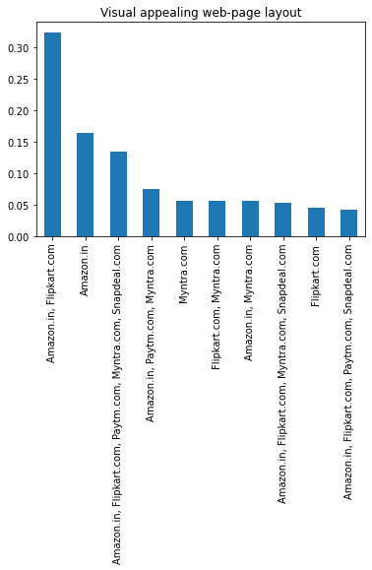
Flipkart and Amazon has visual appealing web-page layout

Slide 7
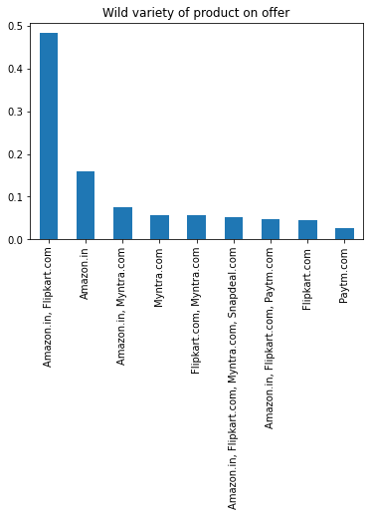
Flipkart and Amazon has wide variety of products

Slide 8
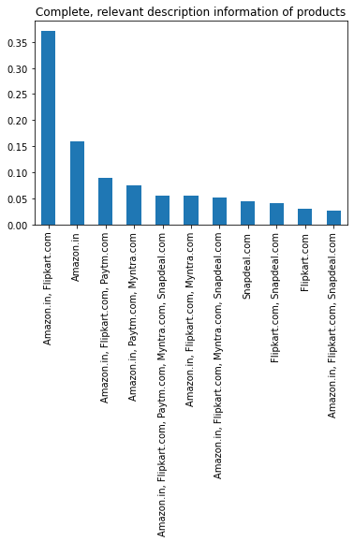
Flipkart and Amazon provide complete and relevant information about products

Slide 9
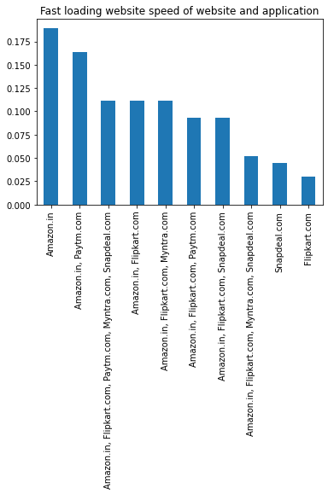
Fast loading website is Amazon.

Slide 10
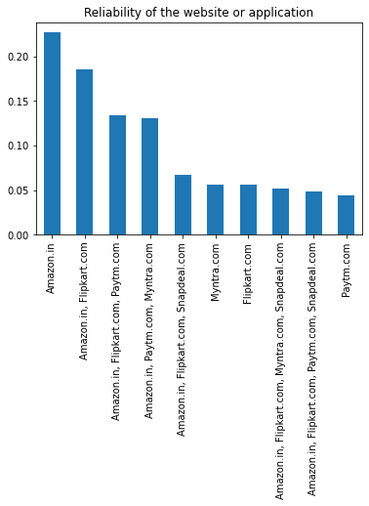
Amazon has maximum Customers reliability

Slide 11
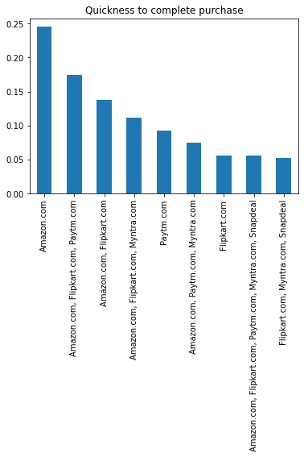
Customers can quickly purchase from Amazon as compare to other e-commerce websites

Slide 12
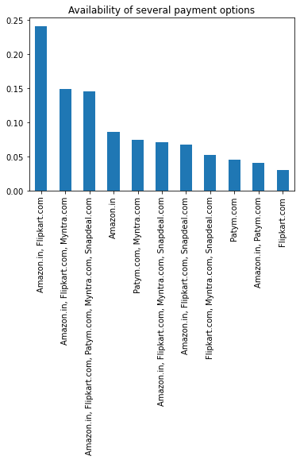
Amazon and Flipkart has wide variety of payment methods available

Slide 13
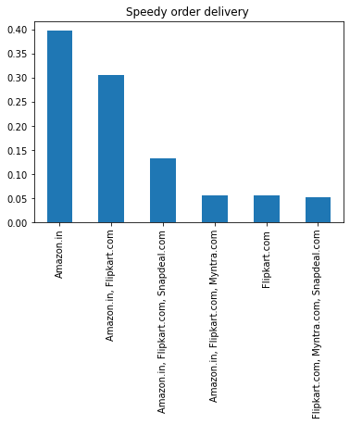
Amazon product delivery is fastest.

Slide 14
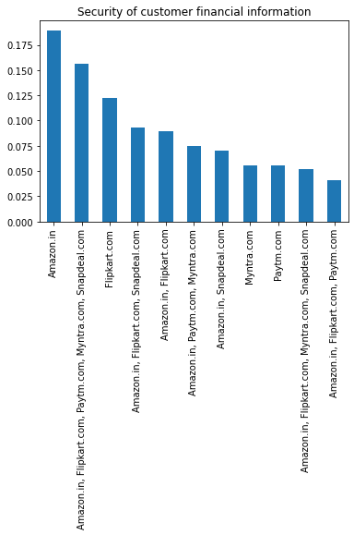
Financial security maximum with Amazon

Slide 15
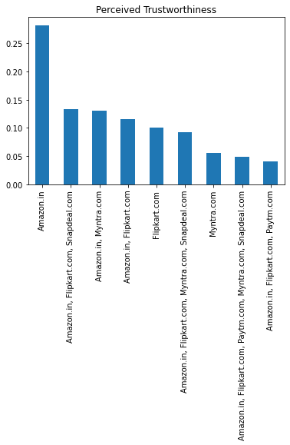
Amazon is trustworthy.

Slide 16
DATA PRE-PROCESSING
Data Cleaning and pre-processing is very important part to create any machine learning model. The cleaner the data will be, the better the prediction will come.
This data provided is raw and we have to run many functions to clean
There is no null value present in our dataset.

Slide 17
CONCLUSION:
We can conclude from the above observation that customers mainly trust on Amazon and that's why Amazon has highest number of sales and in profits.
Amazon take care of customer privacy, financial security also delivers best services in terms of products description, provide wide variety of products and fastest delivery period.
So, We can say that these are the factors which are contributing to catch more customers to shop online

